Slide 1
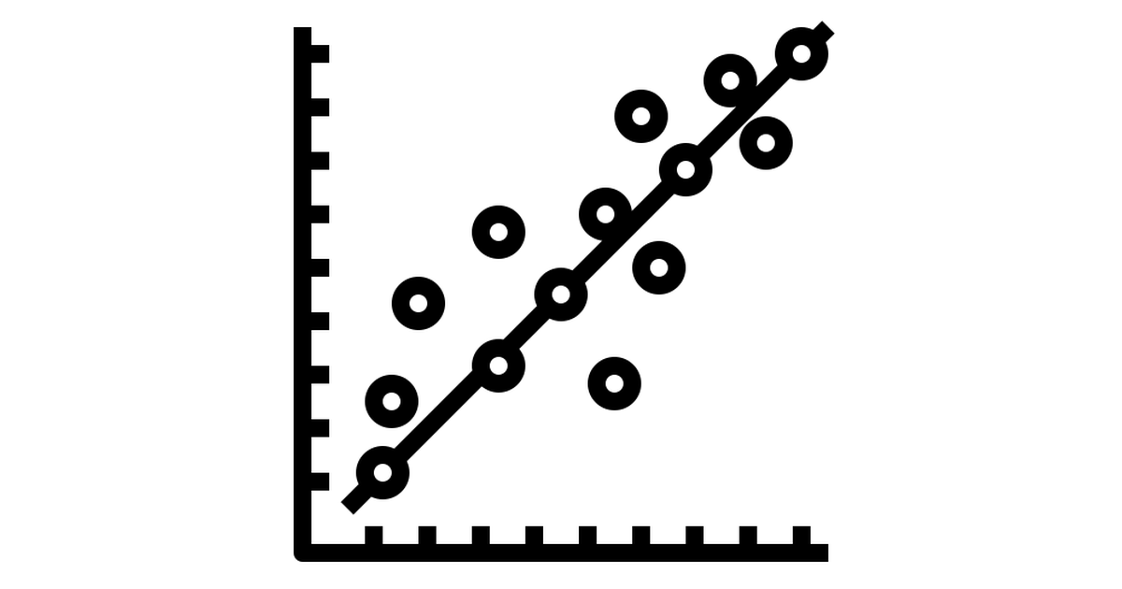
Prediction using Linear Regression Model
Group-2
Srimukha Vasireddy
Raj Kiran Kakarla
Navya Sri Medidhi

Slide 2
Project background
Challenges observed
Introduction to the Data mining technique
Implementation
Results
Analysis of Results
Conclusion
References

Slide 3
Project Background:
Data scientists at BigMart have collected 2013 sales data for 1559 products across 10 stores in different cities in USA . Also, certain attributes of each product and store have been defined. They don’t have an accurate insight on forecasts for the products. To maintain a competitive advantage, it is critical to have insight into future events and outcomes that challenge key assumptions. The aim is to predict up-coming sales of each product at a particular store using a predictive model.
Using predictive model, we will try to understand the properties of products and stores which play a key role in increasing sales in future. These prediction techniques helps the companies to evolve the product efficiently and get back to the market with the better version of it.

Slide 4
Data Set:
We have considered training and test data sets to predict the future sales. So, our main aim is to predict data of missing attribute in testing dataset i.e., “Item_Outlet_Sales” with the help of training dataset.
As, we all know the data in the sales sector is extremely huge to handle. This regression analysis will promote us to predict the future and help in developing the market sales value to meet the customer satisfaction.

Slide 5
Attributes of Data Set
SNO | Variables in data sets | Description of the variable
1 | Item_Identifier | Unique product ID
2 | Item_Weight | Weight of product
3 | Item_Fat_Content | Whether the product is low fat or not
4 | Item_Visibility | The % of total display area of all products in a store allocated to the particular product
5 | Item_Type | The category to which the product belongs
6 | Item_MRP | Maximum Retail Price (list price) of the product
7 | Outlet_Identifier | Unique store ID
8 | Outlet_Establishment_Year | The year in which store was established
9 | Outlet_Size | The size of the store in terms of ground area covered
10 | Outlet_Location_Type | The type of city in which the store is located
11 | Outlet_Type | Whether the outlet is just a grocery store or some sort of supermarket
12 | Item_Outlet_Sales | Sales of the product in the particular store. This is the outcome variable to be predicted.

Slide 6
Challenges Observed:
Data Cleaning:
Data cleaning mainly involves identifying and removing noisy and inconsistent data in order to improve the quality of the data. The main reason for noisy and inconsistent data is during the initial stage, entering incorrect and missing data at the data entry level. This cleaning task is vital, because to take the best possible decision in business implementation.
Some records have Item_Weight as null and we need to clean those records and some records have Outlet_Size has null values. We cleaned the missing data to make the data consistent .
2. Connection:
To observe all the attributes and draw some connections between those attributes to identify the predict variable and response variable. In this case the predict variable is “Item_Outlet_Sales” and it depends on the response variables like Item_Identifier and Outlet_Identifier which are described as the unique product ID. So, this Item_Outlet_Sales depend on the Item_Identifier and Outlet_Identifier. To get the values we considered Item_Identifier + Outlet_Identifier which leads to Item_Outlet_Sales.

Slide 7
Introduction to the Data mining technique
We planned to use one of the predictive models from data mining techniques available. We identified Linear Regression Model is the best model works for the data set identified.
Firstly, Why Linear Regression? This regression model draws the relationship between the dependent and independent variables, where dependent variable is also known as predictor variable and independent variable is known as response variable.
Now let’s investigate What is Linear Regression? This is a statistical analysis that attempts to show the relationship between two variables.
How Linear Regression works? With the data provided by the dataset, we draw a plot between independent and dependent variable and spot a mean value for those values. It selects the best fit line that passes through the mean of the data. But as we know there will be multiple lines that passes through that mean point.

Slide 8
Linear regression attempts to model the relationship between two variables by fitting a linear equation to observed data. One variable is considered to be an explanatory variable, and the other is considered to be a dependent variable. The variable we are predicting is called the criterion variable.
The variable we are basing our predictions on is called the predictor variable. When there is only one predictor variable, the prediction method is called simple regression. To view the fit of the model to the observed data, one may plot the computed regression line over the actual data points to evaluate the results.

Slide 9
Algorithm Implementation:
We observed both training and testing data sets, the training data set contains sales values whereas in testing dataset we don’t have sales values. To predict that, as we draw the connection between attributes to get the predicted values for Item_Outlet_Sales.
The implementation steps in-order to predict the sales of BigMart sales is as follows:
Load the training dataset file into R studio by using “read.csv” R command.
Load the testing dataset file into R studio by using “read.csv” R command.
As there are some missing values in both test and train datasets, clean the missing values by replace the missing values with the mean of the values.
Create a Linear Regression model to get Item_Outlet_Sales based on Item_Identifier and Outlet_Identifier.

Slide 10
Predict the Item_Outlet_Sales for test dataset using predict function. It uses sales values from training dataset, and it does predict the Item_Outlet_Sales for test dataset for each product from specified outlet
Display the values what we have predicted. It does give three values i.e., Best fit value, minimum value and maximum value.
Write the values of Item_Outlet_Sales that we predicted into .CSV file.
R source code

Slide 11
Readme.txt
Readme.txt contains the line by line explanation of algorithm implementation for the source code .
Results:
By implementing all the steps defined , we obtained the values of Item_Outlet_Sales in testing dataset.

Slide 12
Analysis of Results:
Using this linear regression model we predicted the sales amount for each item for its corresponding outlet ID.
With this model we will get three sales values. Those are approximate sales amount , minimum sales amount and maximum sales amount.
Using the sales amounts from Training data set we could identify sales amounts in testing data set.
Conclusion:
Using these predicted values we can forecast the Big Mart sales for each product per each outlet and thus they can invest more on the profitable products.

Slide 13
References:
https://datahack.analyticsvidhya.com/contest/practice-problem-big-mart-sales-iii/
https://towardsdatascience.com/car-selection-and-sales-day-prediction-8c4a474f9dca
https://sebastianraschka.com/blog/2016/model-evaluation-selection-part1.html
http://www.stat.yale.edu/Courses/1997-98/101/linreg.htm
http://onlinestatbook.com/2/regression/intro.html
https://www.sisense.com/glossary/data-exploration/
https://www.youtube.com/watch?v=2Sb1Gvo5si8
https://www.youtube.com/watch?v=zPG4NjIkCjc

